Slide 1
Prioritizing Non coding Variants from Whole genome sequencing project
Sailendra Pradhananga
Toxicity Meeting
08/03/2017

Slide 2
Background
Whole genome sequencing genotypes large number of variants in either population or individual level
Convention association suffers from multiple testing correction for complex traits
Thus prioritizing of variants are done based on specific regions of genome
In our studies, we are aiming for prioritizing low effect non coding variants for Hi-CAP probe sets

Slide 3
Outline of work
Part1 – Comparing genetic variants from WGS 96 Lung cancer patients sample to SweGen 1000 population sequencing
Part 2 – Annotating lung cancer non coding variants from ENCODE, FANTOM (Ref) database
Part 3 – Classify high and low toxicity in lung cancer patients using clustering methods
Part 4 – Enrichment and prioritizing of non coding variants in high and low toxicity phenotype groups

Slide 4
Outline of work
Part1 – Comparing genetic variants from WGS 96 Lung cancer patients sample to SweGen 1000 population sequencing

Slide 5
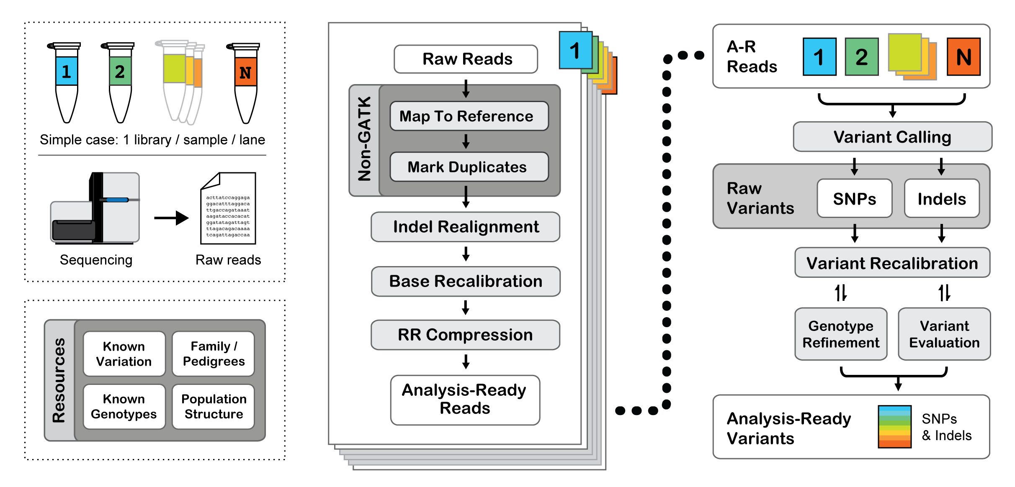
GATK Whole genome sequencing variant calling pipeline
Raw final Variant call in all samples

Slide 6
Comparison of SweGen 1000 with 96 lung cancer sample
70,353 (7.35 % ) of novel SNVs shared by at least 2 individuals
Imputed Allele frequency from SweGen to Lung cancer cohort
SNV counts bet two datasets in Million

Slide 7
Post processing of Variant files
Pass/LC/ Lung cancer cohort VCF (11.9M)
common, low frequency and rare based in SweGen Freq
Common Variants
(MAF> 0.02)
7.12 Mil (60.31%)
Low Frequency variants
(0.02 <= MAF > 0.01)
2.90 Mil (24.45%)
Rare variants
(MAF < 0.01)
1.78 Mil (15.10 %)
Notes:
Ionita-Laza, Iuliana, et al. (2013) provided with empirical classification based
on sample size, n
T = 1/√2n

Slide 8
Outline of work
Part 2 – Annotating lung cancer non coding variants from ENCODE, FANTOM (Ref) database

Slide 9
Annotation of WGS variants
GM12878
Common Variant
Low Frequency Variants
Rare Variants
DNAISE HS
K562
H3K4me2, H3K27Ac
CD20+
FANTOM5
Cage expression
Monocytes,
CD 14+
•
•
•
TF binding sites
CMK
HL-60
Genetic variant from 96 Lung cancer sample
Relevant cell/tissue type
Non coding Functional markers in ENCODE and FANTOM5

Slide 10
Approach
For each variants we annotated with different functional noncoding markers of relevant cell types.
In the initial study we annotated variant with individual cell type.
Subsequently, aggregated approach to find variants active in different cell-types with different functional elements.

Slide 11
Cell type | Overlapping DNAseI HS | Overlapping Histone marks | Overlapping FATHOM 5 | Number of TFs | Overlapping TF binding sites
K562 | 136,213 | 1,920,252 | 6,305 | 98 | 403,298
GM12878 | 121,075 | 1,709,964 | 12,781 | 73 | 390,283
CD20+ | 74,723 | 1,282,537 | - | - | -
Mon-CD14+ | 92,522 | 1,427,523 | 12641 | - | -
CMK | 91,622 | - | - | - | -
HL-60 | 106,273 | - | 5,811 | 1 | 19,024

Slide 12
Cell-type | Total NC- ANN features | NC-ANN Common | NC-ANN Low freq | NC_ANN Rare freq
K562 | 3,429,808 | 2,027,386 | 865,272 | 537,150
GM12878 | 1,834,449 | 1,072,818 | 467,122 | 294,509
CD20+ | 74,723 | 42,315 | 19,919 | 12,489
MON-CD40+ | 1,445,273 | 850,801 | 365,498 | 228,974
CMK | 91,622 | 52,149 | 24,219 | 15,254
HL-60 | 118,441 | 67,084 | 31,408 | 19,949

Slide 13
3798 variants
?
2.11 Mil Common variants annotated with non coding functional DNA elements

Slide 14
2265
?
907 thousand low frequncy annotated with non coding functional DNA elements
Notes:
907,208

Slide 15
1489
?
570 thousand rare variants annotatednon non coding functional DNA elements
Notes:
570,195

Slide 16
Thus we have…
To devise and prioritize variants based on low and high toxicity of lung cancer patients
We used the blood cell count values platelets(TPK), leucocytes(LPK), neutrophils(NPK) after drug administration
Cluster each variants in high and low toxicity for each TPK, LPK and NPK phenotype and combined phenotype

Slide 17
Outline of work
Part 3 – Classify high and low toxicity in lung cancer patients using clustering methods

Slide 18
Clustering results
Using unsupervised Kmeans clustering at K=2
Blood count values of all phenotype as an input
HT | LT
54 | 42

Slide 19
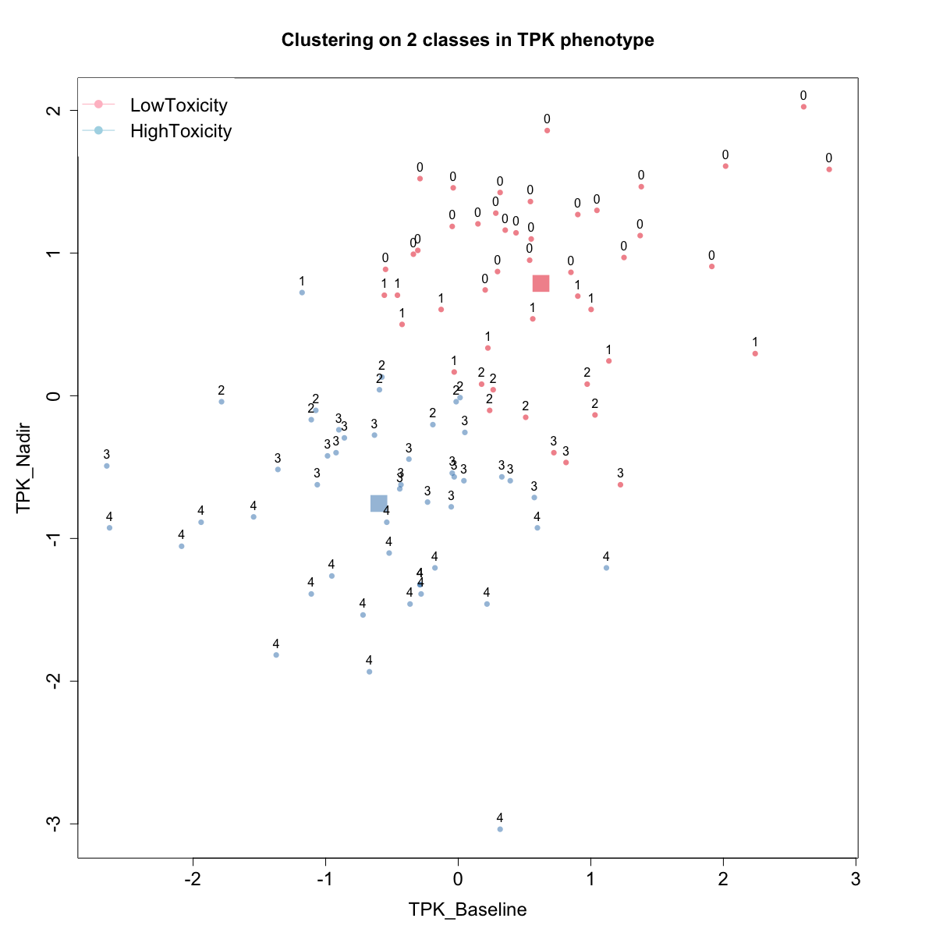
TPK at K=2
Clustering results | Original Labels in CTC
 | 0 | 1 | 2 | 3 | 4
Red | 27 | 11 | 6 | 3 | 0
Blue | 0 | 3 | 12 | 23 | 20
HT | LT
49 | 47

Slide 20
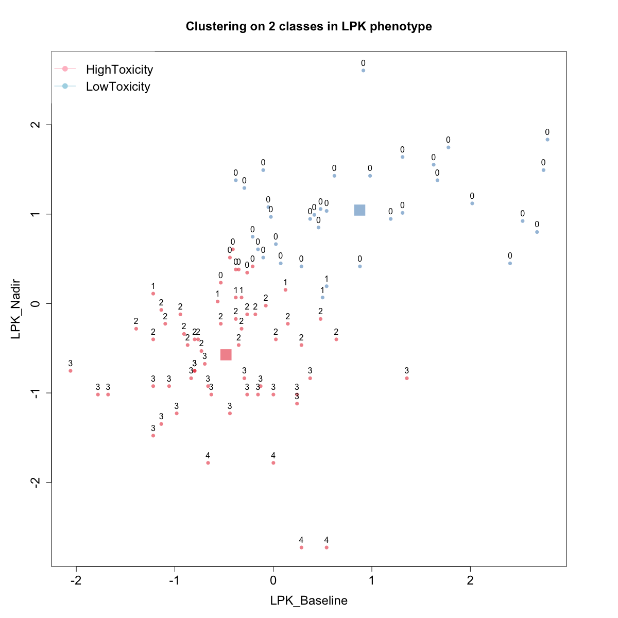
LPK at K=2
Clustering results | Original Labels in CTC
 | 0 | 1 | 2 | 3 | 4
LT | 32 | 2 | 0 | 0 | 0
HT | 7 | 5 | 22 | 24 | 4
HT | LT
62 | 34

Slide 21
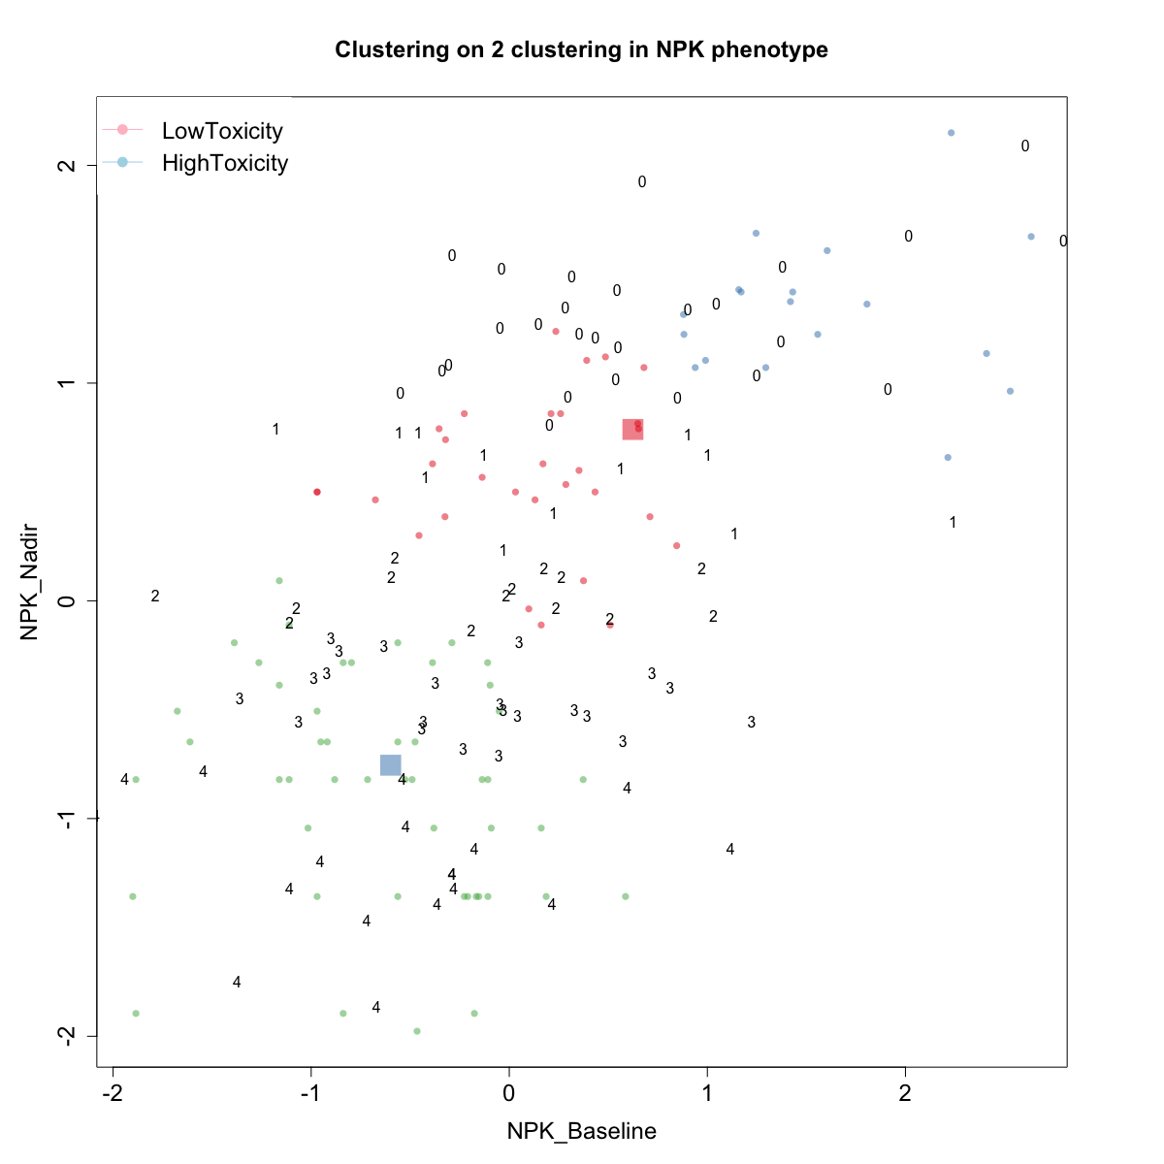
NPK at K=2
Clustering results | Original Labels in CTC
 | 0 | 2 | 3 | 4
1 | 39 | 2 | 0 | 0
2 | 5 | 4 | 18 | 28
HT | LT
55 | 41

Slide 22
Outline of work
Part 4 – Enrichment and prioritizing of non coding functional variants in high and low toxicity phenotype groups

Slide 23
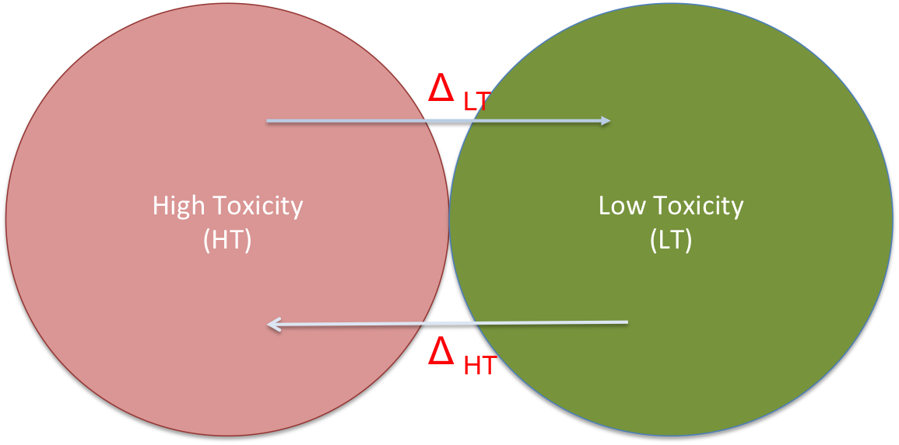
Imputing toxicity score in each phenotypic groups
Hypothesis:
In each toxicity group enrichment of variants is attributed in delta value which is proportion of minor allele frequency in each group.
For each variants in all group
Delta score defined as:
Δ _{HT} = (MAF_HT ∕ MAF_LT)
Δ _{LT} = (MAF_LT∕ MAF_HT)

Slide 24
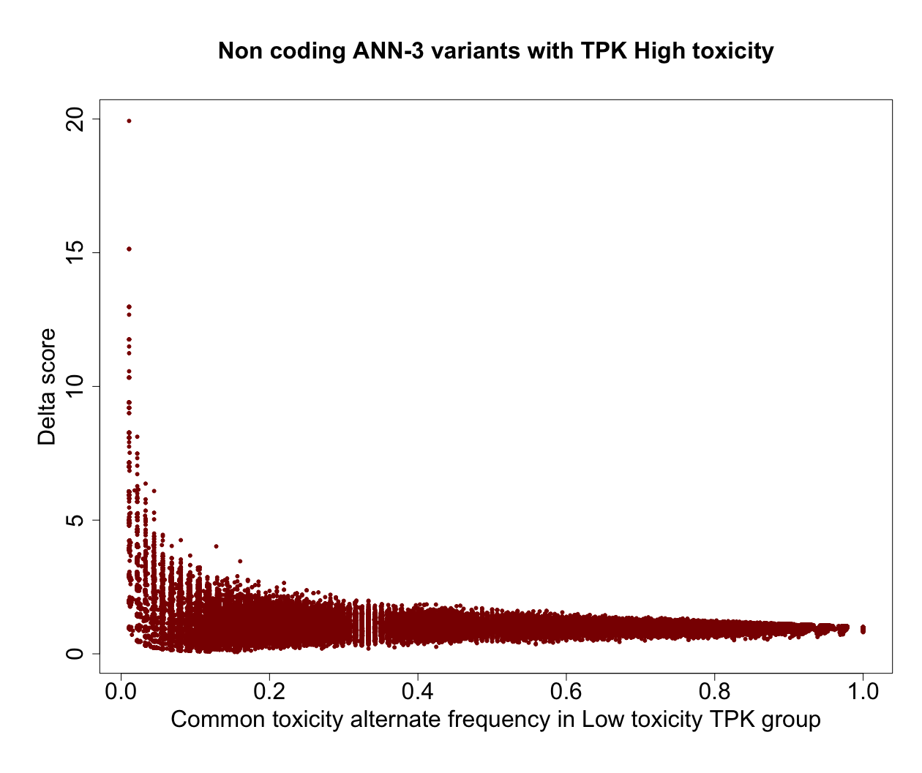
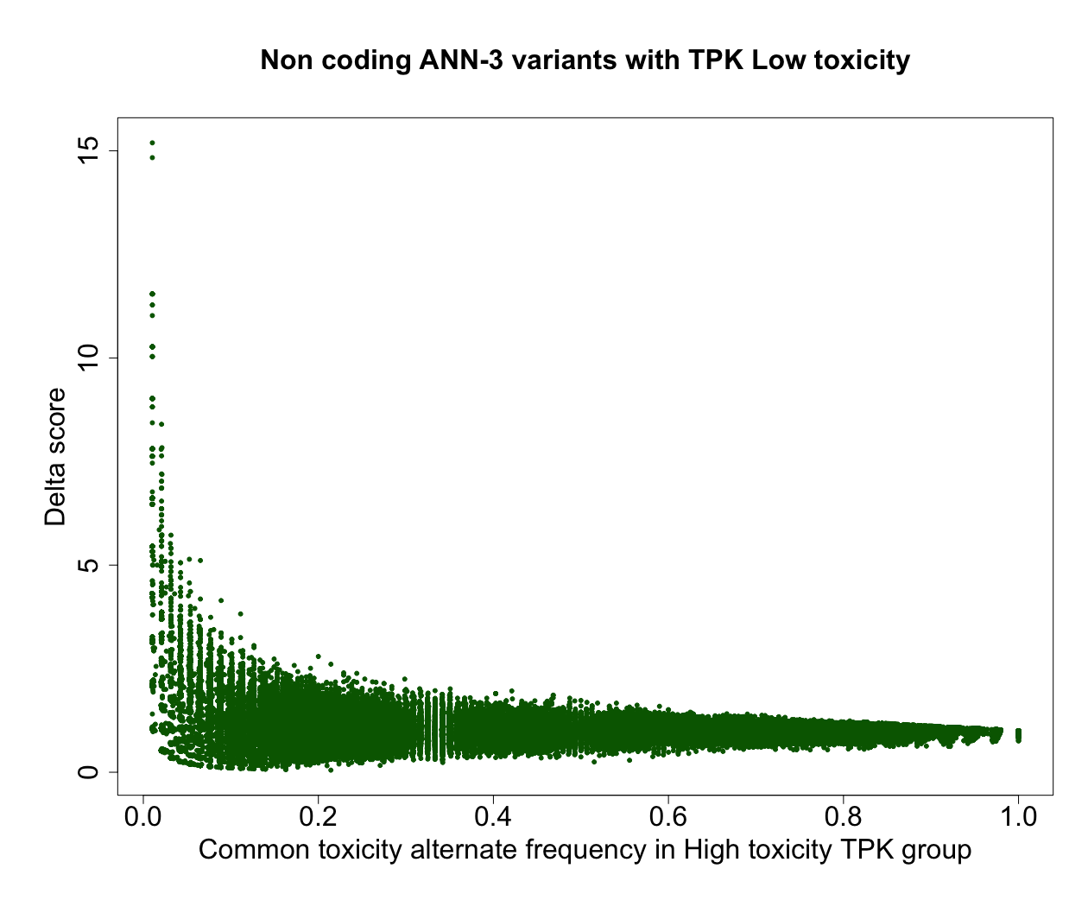
Common Variant ANN:3: Phenotype TPK
Variants with high Δ _{LT}
Variants with high Δ _{HT}
Δ _{HT} and Δ _{LT} observed in TPK Phenotype

Slide 25
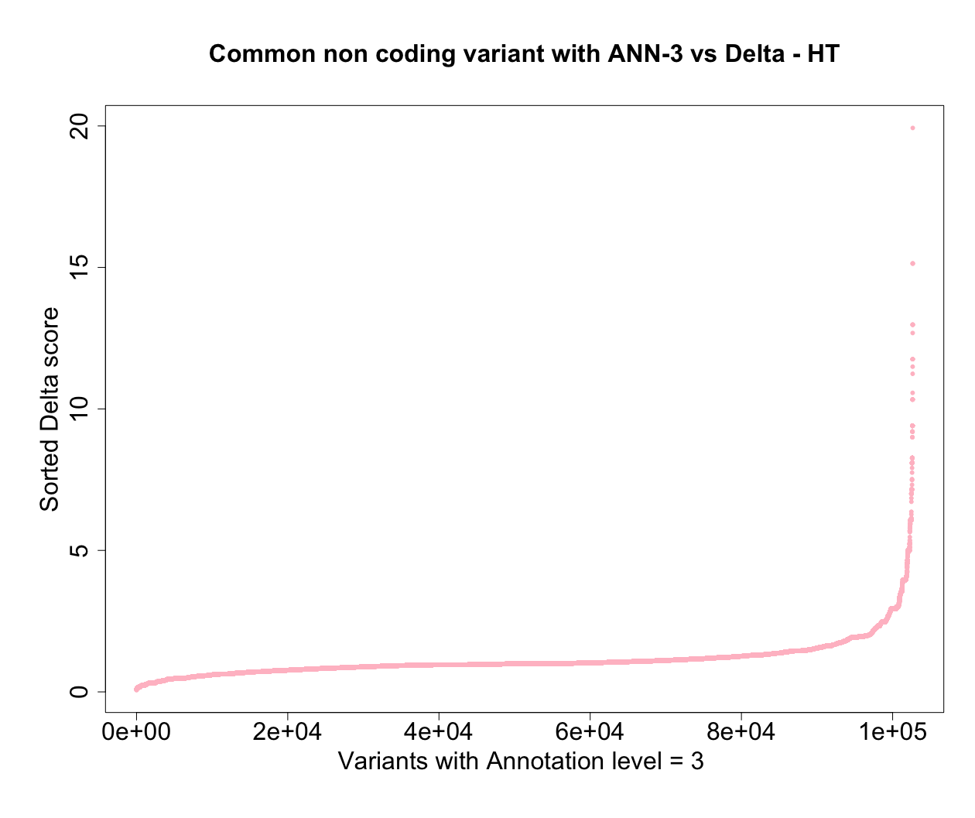
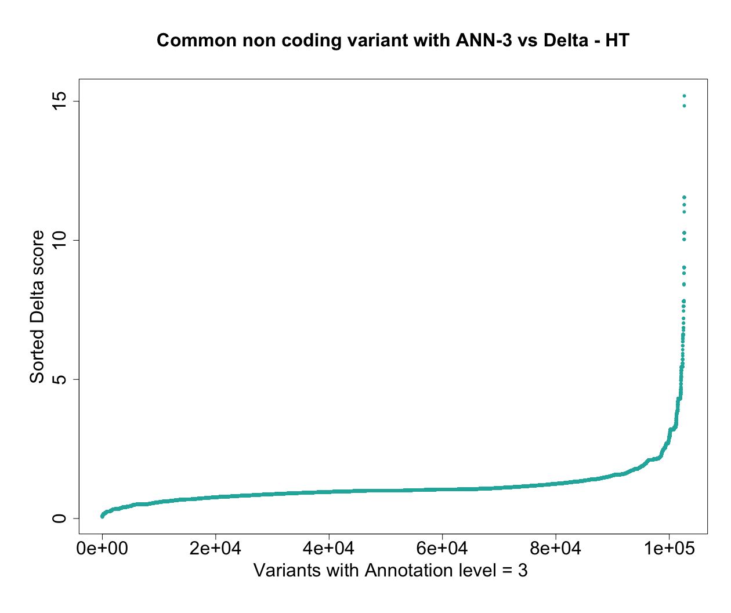
?
However, optimum thresholding of Delta is not certain

Slide 26
Furthermore,
Similar pattern observed in all other phenotypes
Enrichment of variants were observed in two groups

Slide 27
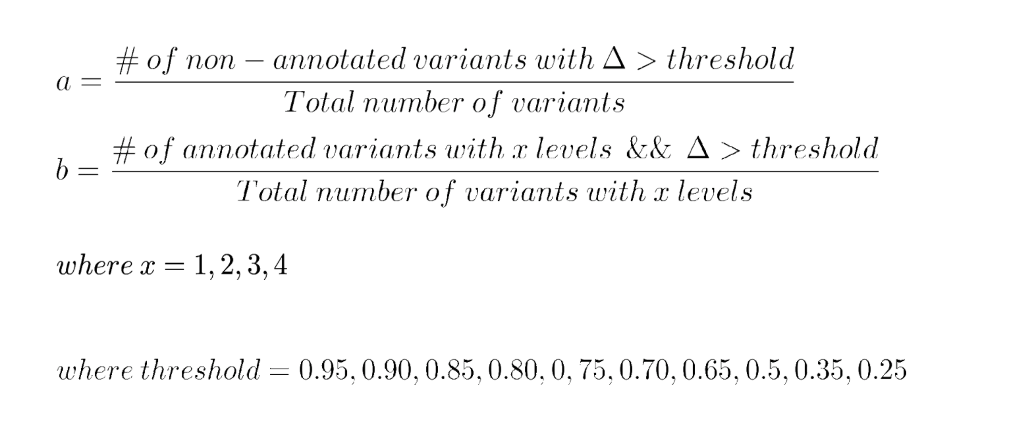
Enrichment status for Common variants
Non coding variants annotated with functional elements in different cell types.
Hypothesis : increase of annotation level of a variant means adding of functionality to variants with removal of random variants.
Do :
Test Enrichment status b/a with different threshold level to find optimum threshold and annonation level for each varaints

Slide 28
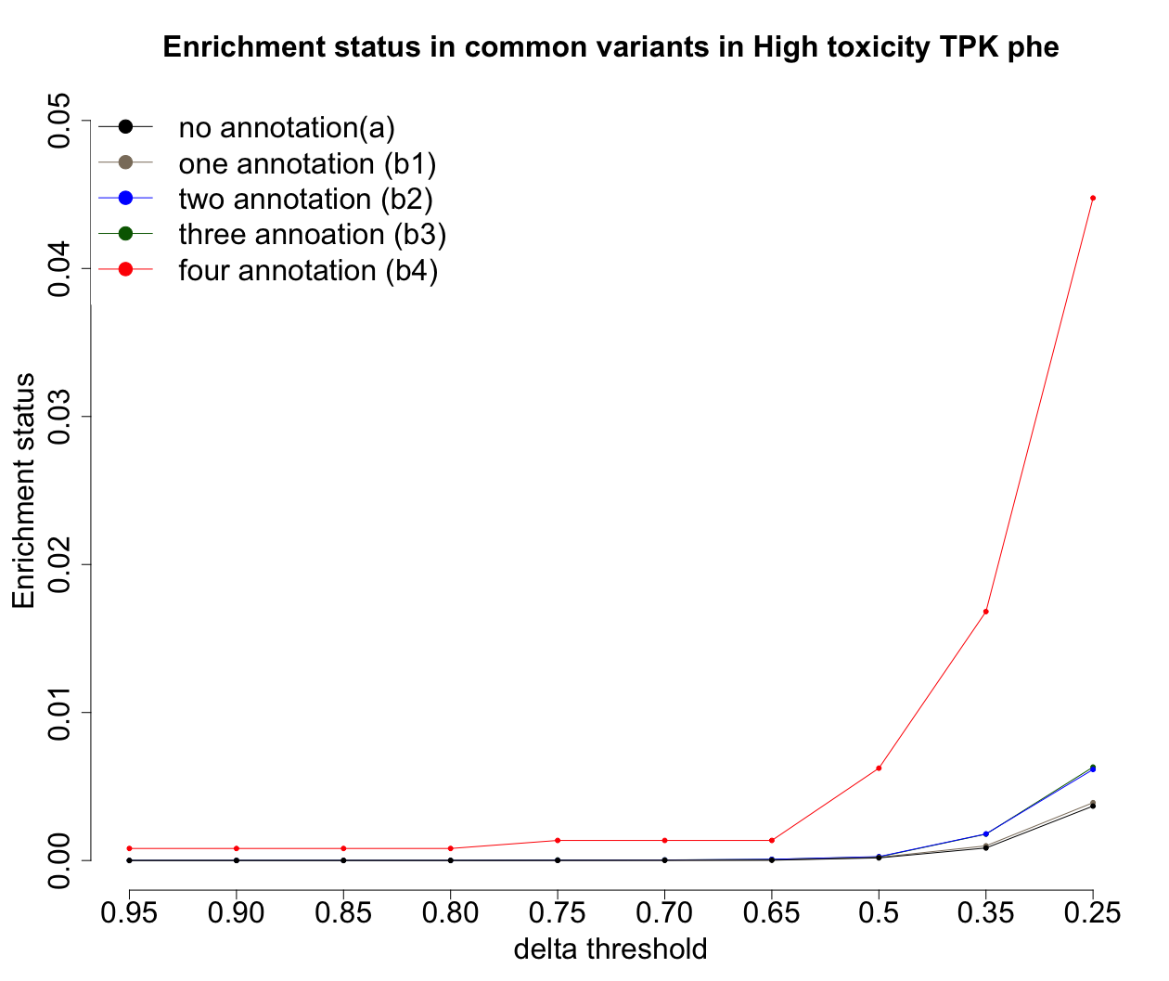
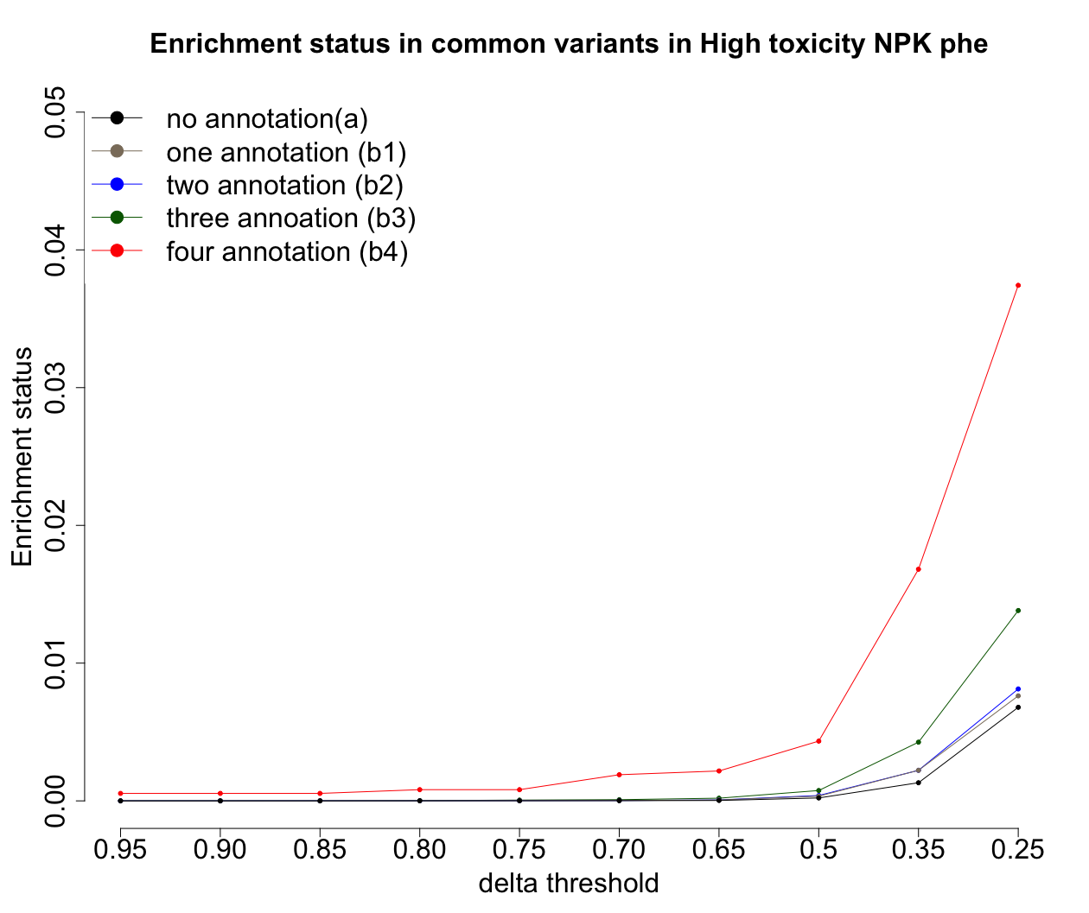
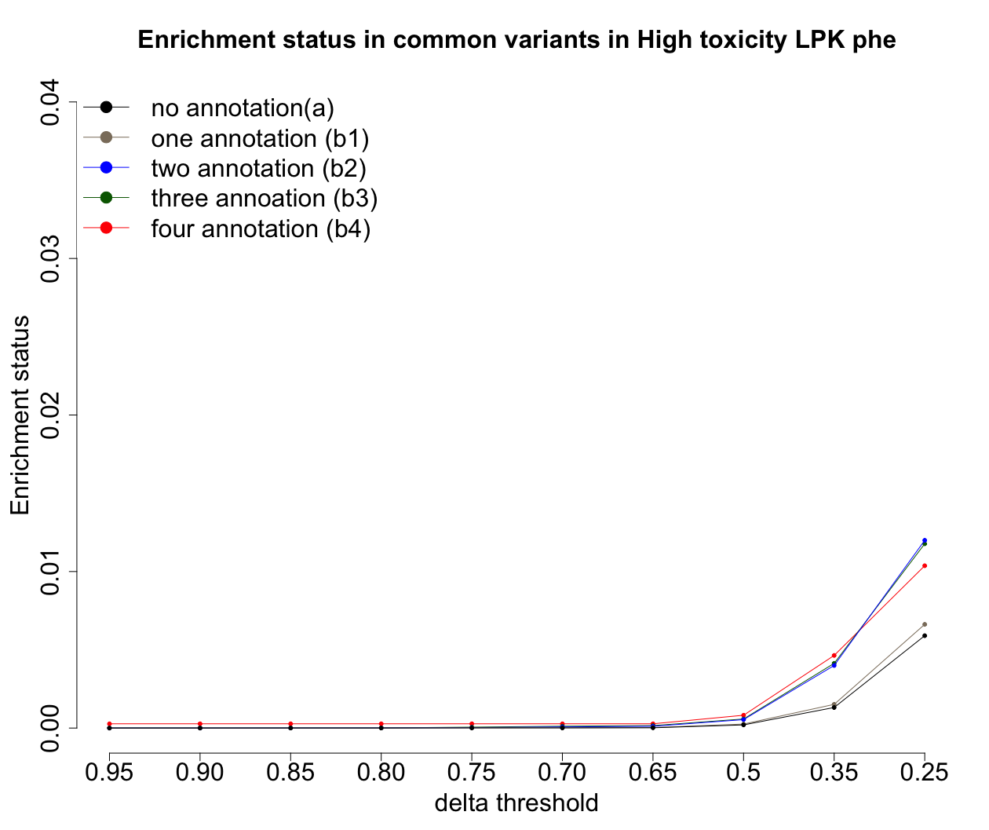
Common variants with enrichment status in High Toxicity
Trading off between number of variant and annotation level
Delta Threshold of 0.5 and Annotation level = 3 and 4

Slide 29
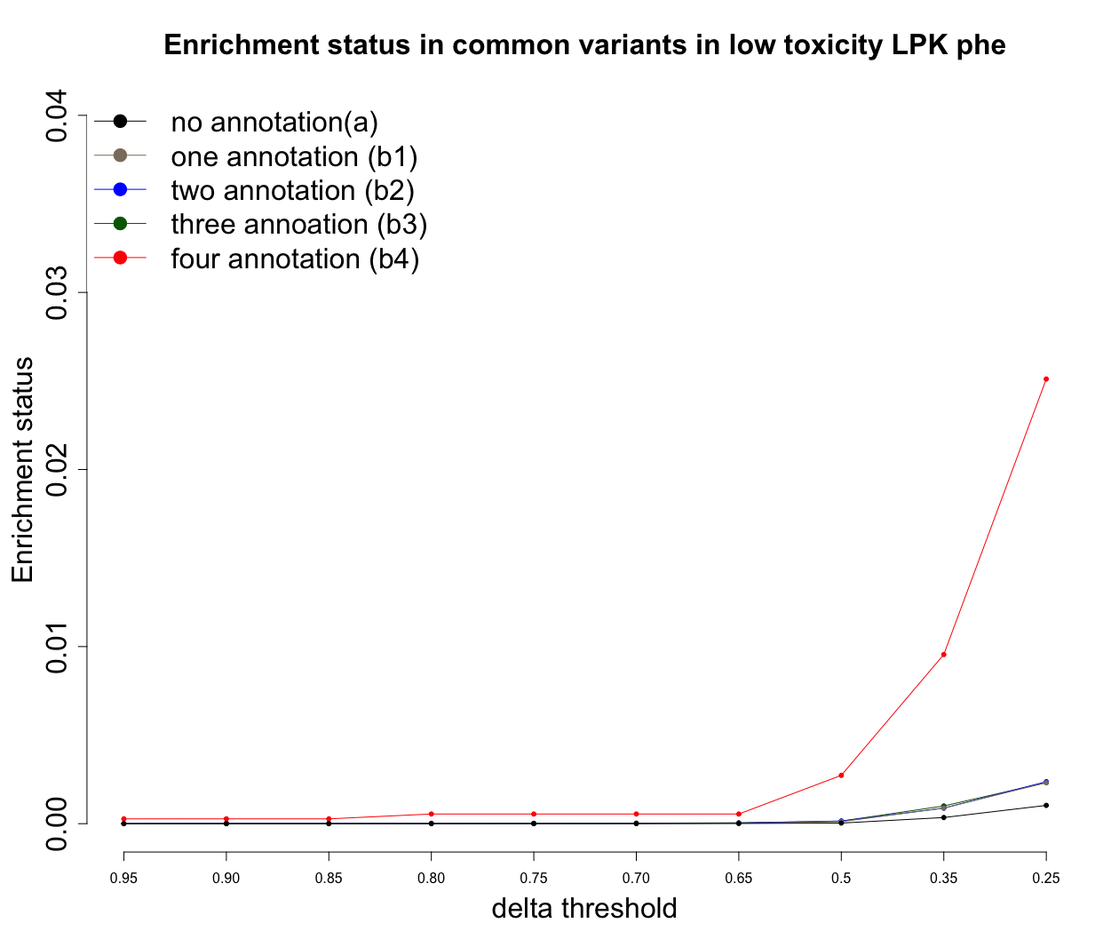
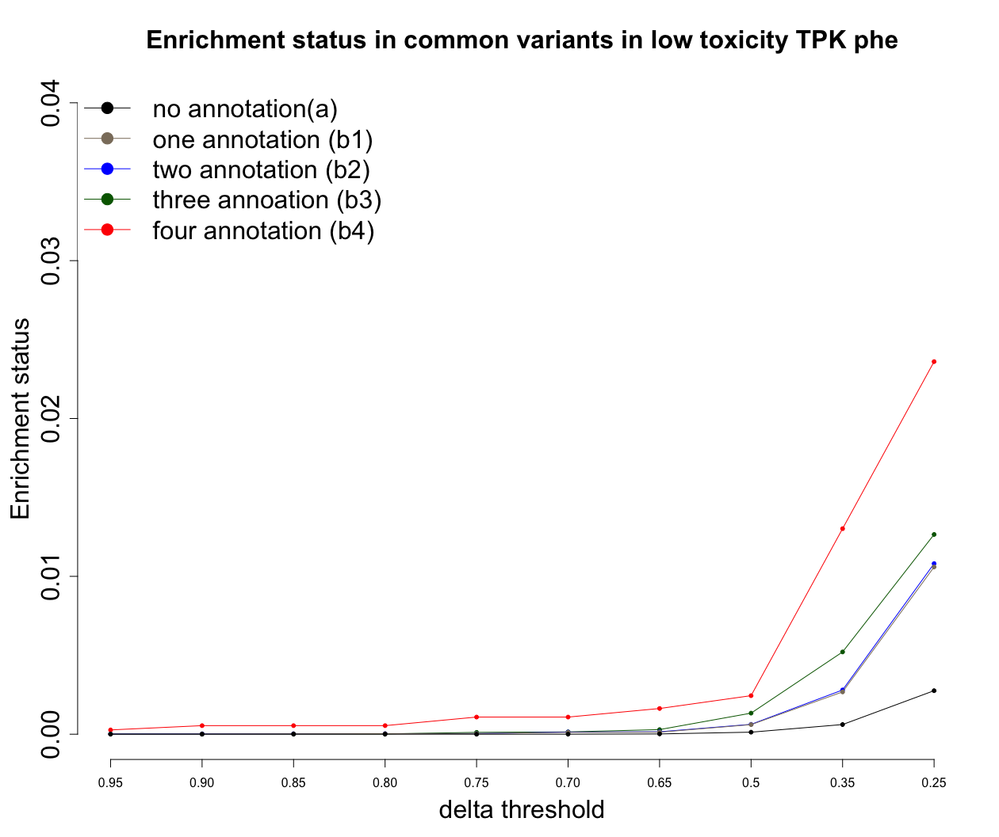
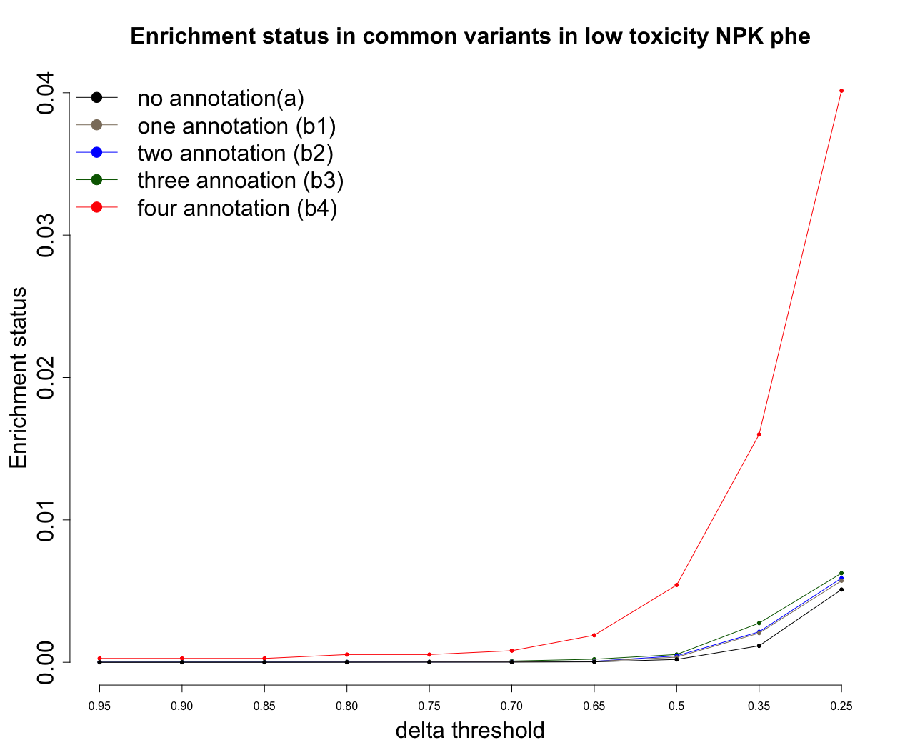
Common variants with enrichment status in Low Toxicity
Trading off between number of variant and annotation level
Delta Threshold of 0.5 and Annotation level = 3 and 4

Slide 30
Finally,
Using threshold of 0.5 and Annotation level of 3 and 4, we prioritized 48,62 and 93 variants with functionality marks for high toxicity for TPK, LPK and NPK
Similarly, using the same principal we have prioritized 146,12 and 76 enriched variants with non coding function for all low toxicity groups
Additionally adding variants specific to each toxicity groups, we have prioritized 1381, 2872, 1905 for HT
1293,540 and 830 for LT
(see associated table prioritized_variants_numbers.csv file)

Slide 31
On pipeline: Needs Discusssion
Ideal goal :- Prioritized variant list of 3000 from 15 M variants for Common, LF and Rare
Add p-values for variants using hyper geometric distribution
Variants from LF and rare needs further pruning
Design probe-set for Hi-CAP studies with prioritized variants for selected cell lines MolM1, CMK
Study interaction dynamics in variants with HiCAP analysis

Slide 32

Acknowledgements
Prof. Joakim Lundeberg
Asst Prof. Pelin Sahlen
Assoc Prof. Henrik Green
Niclas Bjorn
Complex disease group

